Slide 1


Course Title: Data Structure
Course Code : CSE123
Thanjida Akhter : 102-15-1030

Slide 2
Topic
Stack & Arithmetic Expression

Slide 3
What is a Stack?
A stack is a data structure in which data is added and removed at only one end called the top.
To add (push) an item to the stack, it must be placed on the top of the stack.
To remove (pop) an item from the stack, it must be removed from the top of the stack too.
Thus, the last element that is pushed into the stack, is the first element to be popped out of the stack.
  i.e., A stack is a Last In First Out (LIFO) data structure

Slide 4
An Example of a Stack
2
8
1
7
2
8
1
7
2
top
1
7
2
top
Push(2)
top
Push(8)
pop()
8
1
7
2
top
1
7
2
7
2
top
pop()
top
pop()

Slide 5
Infix expression: In infix notation the functions are placed between their operands, such as "1+2". Although infix notation is limited to binary functions most languages mix infix notation with prefix or postfix notation, as a form of syntactic sugar.
Example: A+(B*C)
Postfix expression: If E is an atomic infix expression then the equivalent postfix expression corresponding to E is E itself.
Example: A BC*+

Slide 6
Police postfix notation: It does not need parentheses conventions to indicate the order of the computation the order is defined completely by the relation order of operands and operators.
Prefix expression: A letter or group of letters attached to the beginning of a word that partly indicates its meaning.
Example: *+A BC

Slide 7
Precedence and their value
(^) ----------→ 2
(/,*) ----------→ 1
(+,-) ---------→ 0

Slide 8
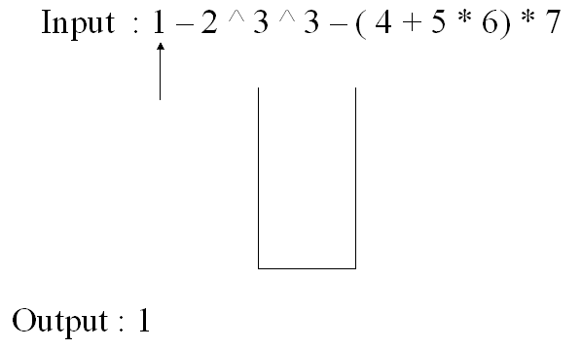
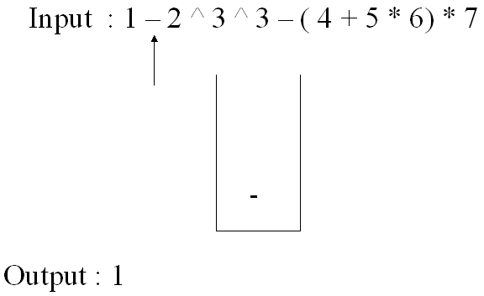
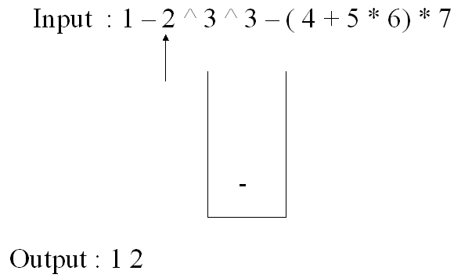
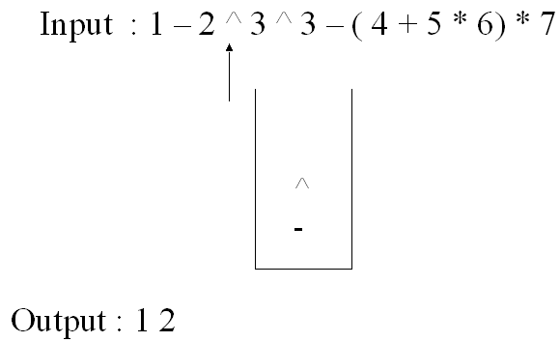
Infix to postfix conversation
step1:
step2:
step3:
step4:

Slide 9
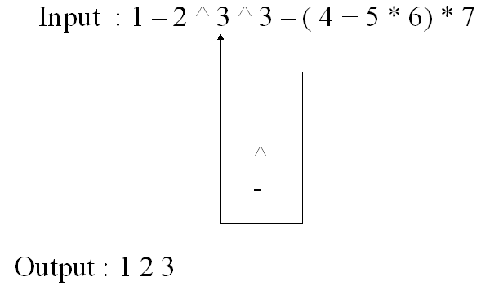
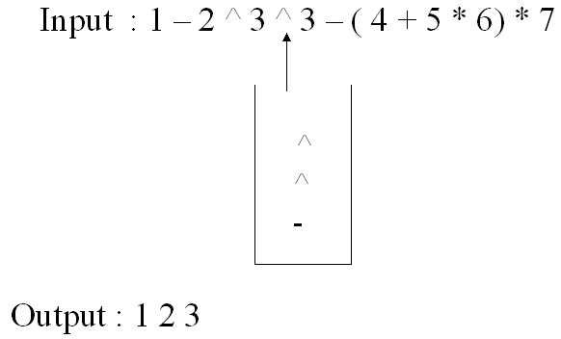
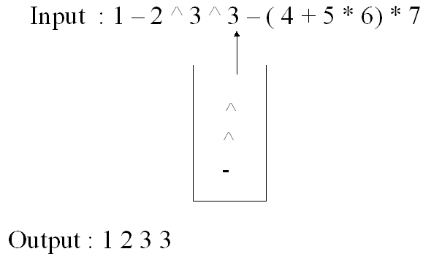
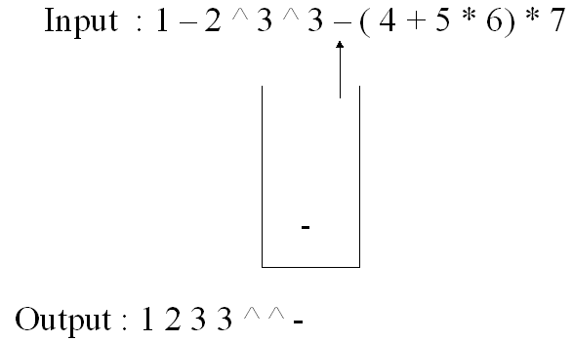
Infix to postfix conversation
.
step5:
step6:
step7:
step8:

Slide 10
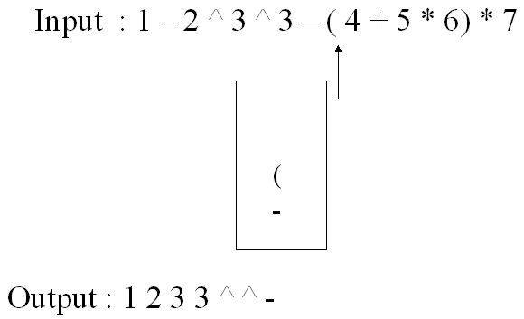
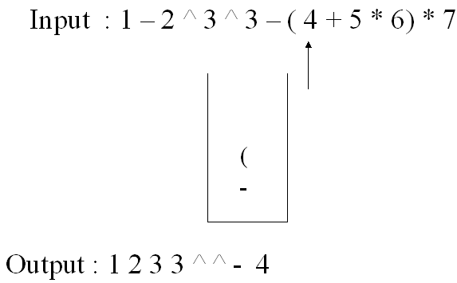
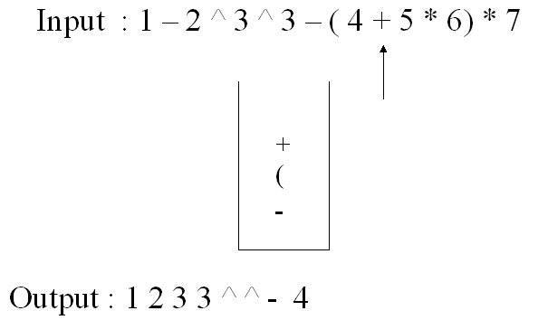
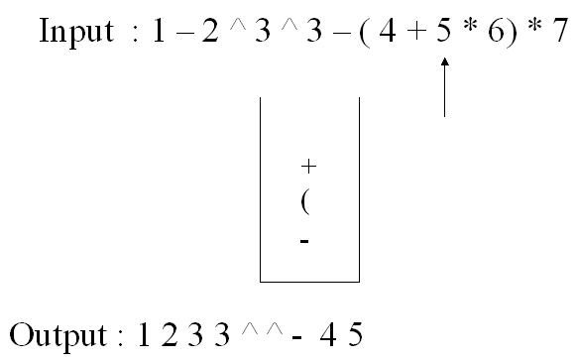
Infix to postfix conversation
step9:
step10:
step11:
step12:

Slide 11
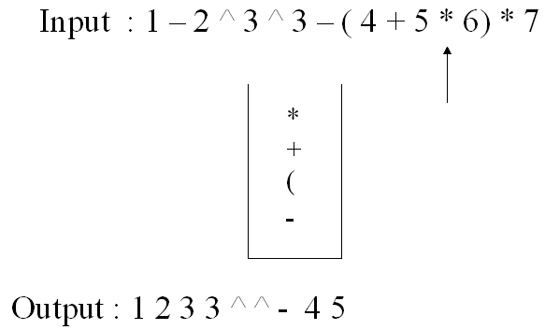
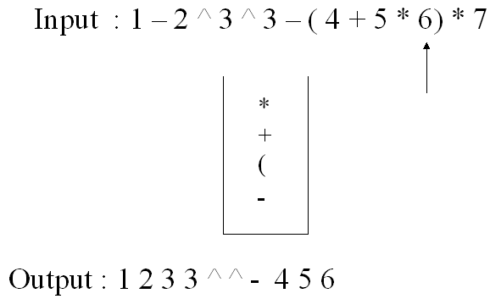
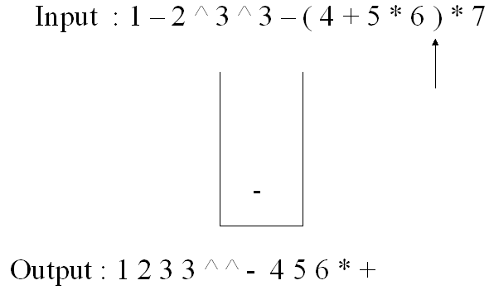
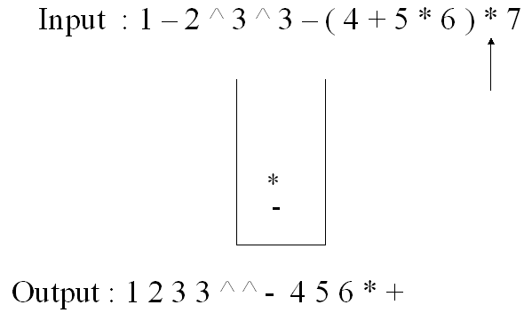
Infix to postfix conversation
.
step13:
step14:
step15:
step16:

Slide 12
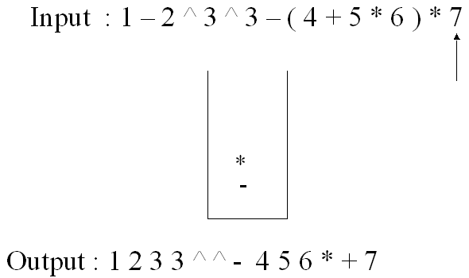
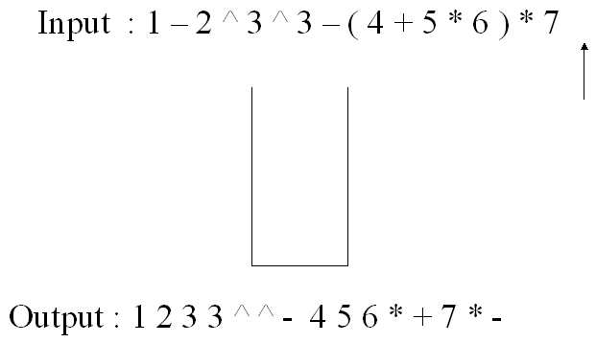
Infix to postfix conversation
.
step17:
step18:

Slide 13
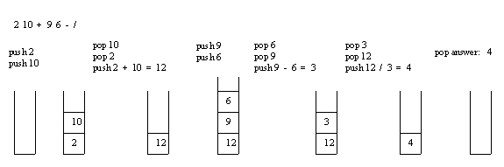
Evaluating Postfix Expression
Example: Consider the postfix expression, 2 10 + 9 6 - /

Slide 14
THANK
YOU

